Slide 1
Defining a New Set of Optimal Entanglement Witnesses
Arianna Meinking
Advisor: Prof. Theresa Lynn
Notes:
Quantum entanglement is a resource that will be useful in quantum cryptography

Slide 2
Why?
Quantum entanglement is useful!
We need to know about whether a state is entangled
(of my research)
(a couple questions)

Slide 3
Entanglement

Slide 4
What is Entanglement?
(Assume the cat is a photon)
1
Polarization
2
Favorite Color
Notes:
Horizontally polarized cat!

Slide 5
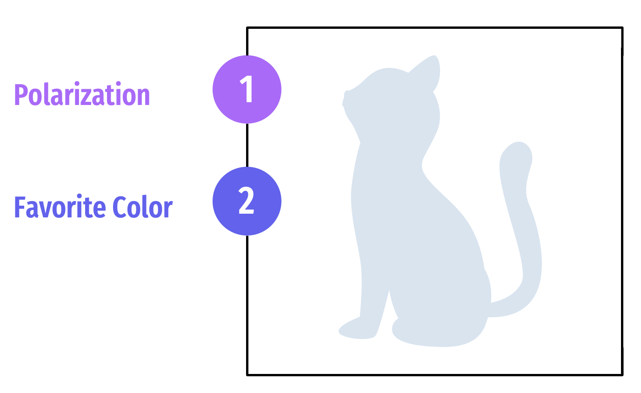
What is Entanglement?
A
B

Slide 6
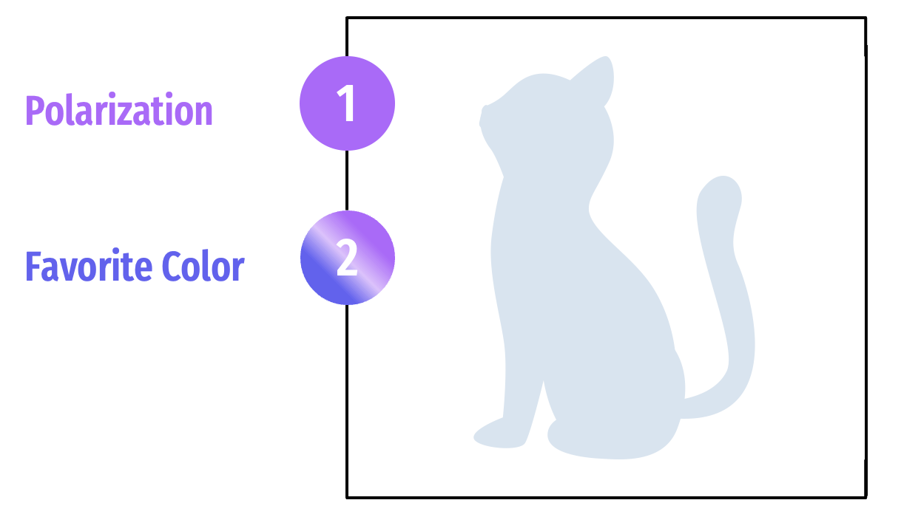
What is Entanglement?
A
B

Slide 7
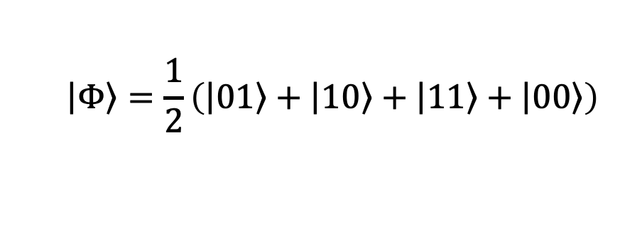
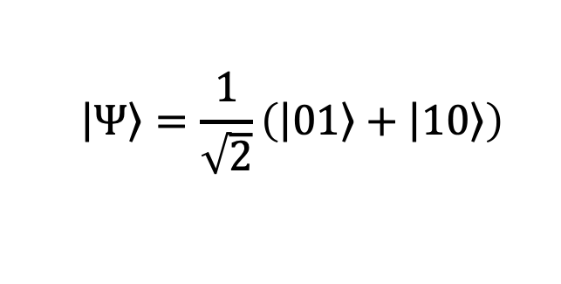
Example Entangled State(s)?
$$\left|\left.Φ\right\rangle \right.=\frac{1}{2}\left(\left|\left.01\right\rangle \right.+\left|\left.10\right\rangle \right.+\left|\left.11\right\rangle \right.+\left|\left.00\right\rangle \right.\right)$$
A
B
$$\left|\left.Ψ\right\rangle \right.=\frac{1}{\sqrt{2}}\left(\left|\left.01\right\rangle \right.+\left|\left.10\right\rangle \right.\right)$$

Slide 8
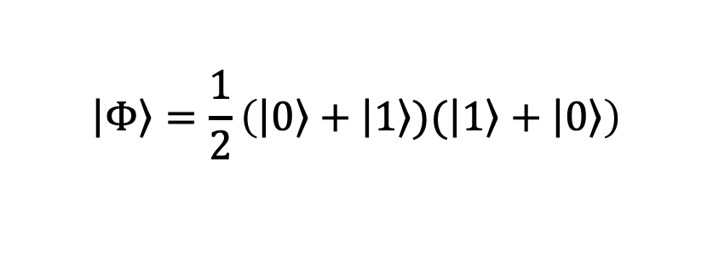
Example Entangled State(s)?
$$\left|\left.Φ\right\rangle \right.=\frac{1}{2}\left(\left|\left.0\right\rangle \right.+\left|\left.1\right\rangle \right.)(\left|\left.1\right\rangle \right.+\left|\left.0\right\rangle \right.\right)$$
$$\left|\left.Ψ\right\rangle \right.=\frac{1}{\sqrt{2}}\left(\left|\left.01\right\rangle \right.+\left|\left.10\right\rangle \right.\right)$$

Slide 9
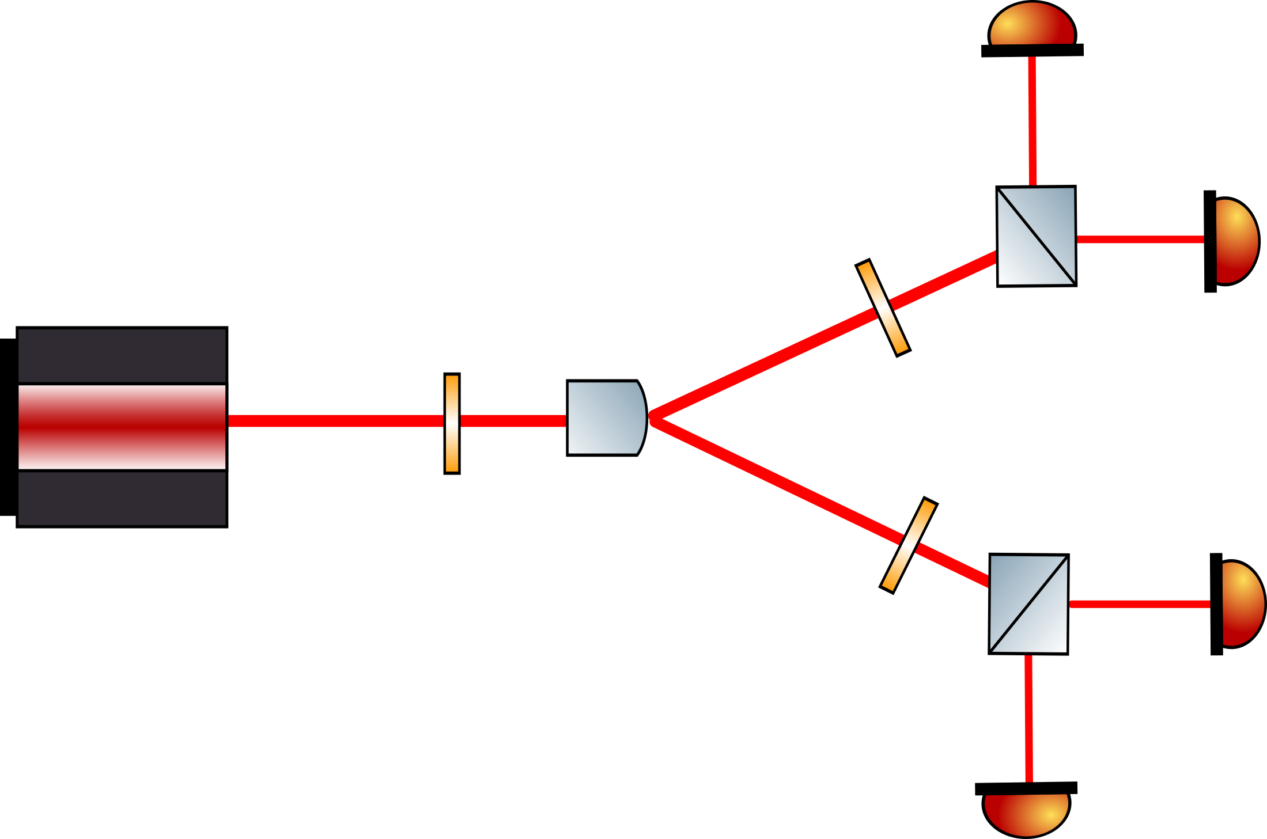
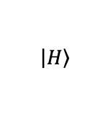
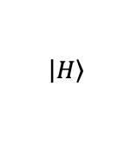
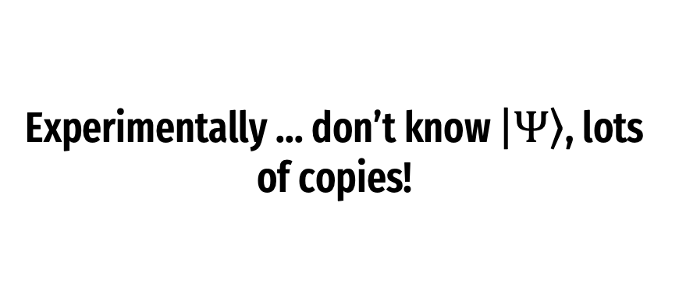


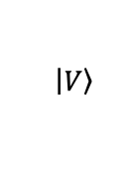

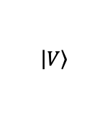
Experimentally ... don’t know $\left|\left.Ψ\right\rangle \right.$, lots of copies!
$$\left|\left.H\right\rangle \right.$$
A
$$λ/2$$
$$\left|\left.V\right\rangle \right.$$
$$λ/2$$
$$\left|\left.V\right\rangle \right.$$
$$λ/2$$
B
$$\left|\left.H\right\rangle \right.$$

Slide 10
Experimentally ...
A
B

Slide 11
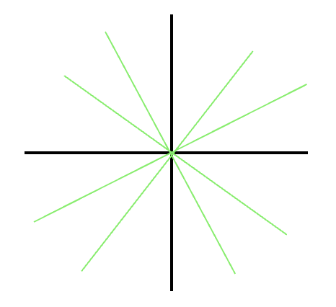
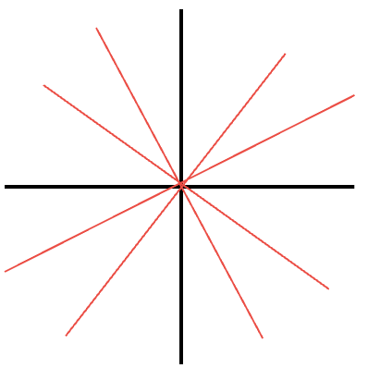
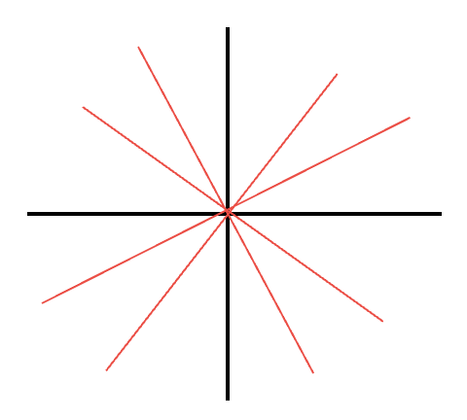
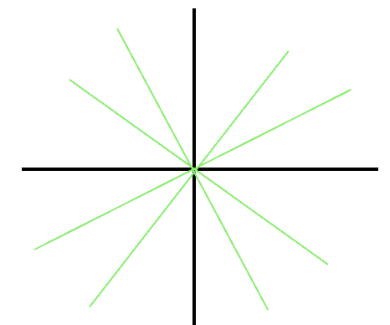
Experimentally ...
A
B

Slide 12
Experimentally ...
A
B
Notes:
5 min

Slide 13
Witness Operator

Slide 14
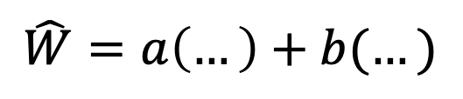


Witness Operator
$$\hat{W}=a\left(…\right)+b(…)$$
Operator we design to determine entanglement
Entangled!!
$$\left\langle \hat{W}\right\rangle ≤0$$
$$(a^{2}+ b^{2}=1)$$

Slide 15
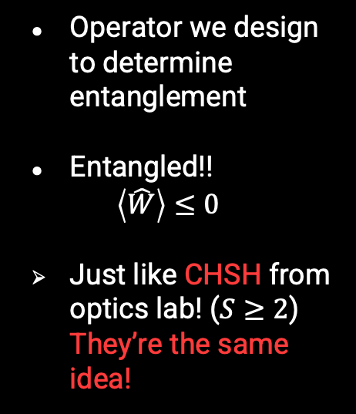
Witness Operator
$$\hat{W}=a\left(…\right)+b(…)$$
Operator we design to determine entanglement
Entangled!!
$$\left\langle \hat{W}\right\rangle ≤0$$
Just like CHSH from optics lab! ($S≥2$) They’re the same idea!
$$(a^{2}+ b^{2}=1)$$

Slide 16

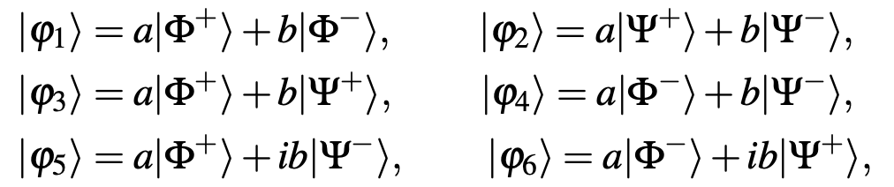
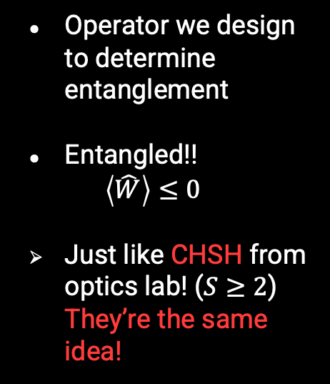
Witness Operator
(a partial transpose over particle B states)
Operator we design to determine entanglement
Entangled!!
$$\left\langle \hat{W}\right\rangle ≤0$$
Just like CHSH from optics lab! ($S≥2$) They’re the same idea!
6 in the W set!
(Riccardi et. al)

Slide 17
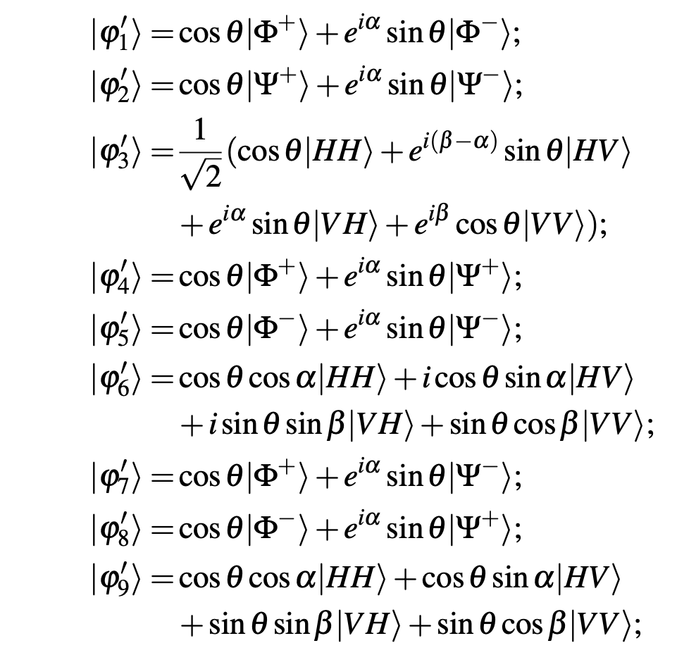
Witness Operator
Operator we design to determine entanglement
Entangled!!
$$\left\langle \hat{W}\right\rangle ≤0$$
Just like CHSH from optics lab! ($S≥2$) They’re the same idea!
9 in the W’ set!
(Eritas Yang, Becca Verghese, Ben Hartley)

Slide 18
Two-Stage Witnessing

Slide 19

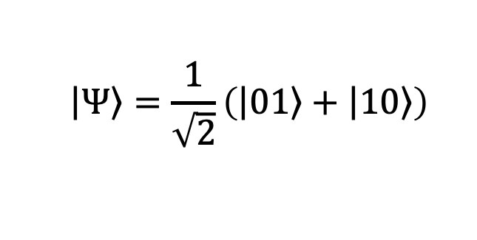

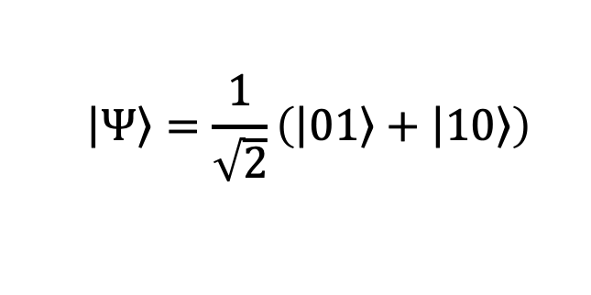



Two-Stage Process
1ST
$$\left|\left.Ψ\right\rangle \right.=\frac{1}{\sqrt{2}}\left(\left|\left.01\right\rangle \right.+\left|\left.10\right\rangle \right.\right)$$
$$≤0$$
try
$$\left\{\hat{W}\right\}$$
Entangled!
2ND
$$≥0$$
$$\left|\left.Ψ\right\rangle \right.=\frac{1}{\sqrt{2}}\left(\left|\left.01\right\rangle \right.+\left|\left.10\right\rangle \right.\right)$$
$$≤0$$
try
$$\left\{\hat{W}′\right\}$$
Entangled!
$$≥0$$
Grouped in 3s …
Hmmm…

Slide 20

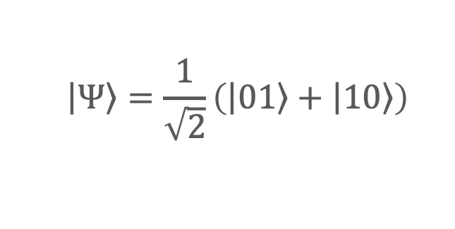


Two-Stage Process
1ST
$$\left|\left.Ψ\right\rangle \right.=\frac{1}{\sqrt{2}}\left(\left|\left.01\right\rangle \right.+\left|\left.10\right\rangle \right.\right)$$
$$≤0$$
try
$$\left\{\hat{W}\right\}$$
Entangled!
2ND
$$≥0$$
$$\left|\left.Ψ\right\rangle \right.=\frac{1}{\sqrt{2}}\left(\left|\left.01\right\rangle \right.+\left|\left.10\right\rangle \right.\right)$$
$$≤0$$
try
$$\left\{\hat{W}′\right\}$$
Entangled!
$$≥0$$
Grouped in 3s …
Hmmm…

Slide 21
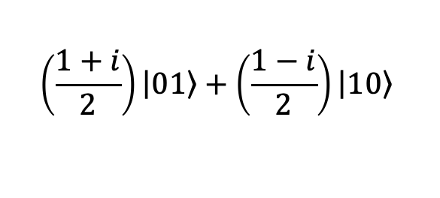
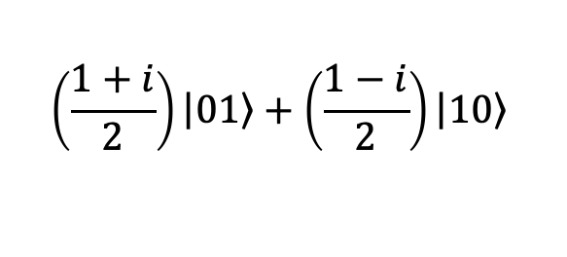
Two-Stage Process
1ST
$$≤0$$
$$\left(\frac{1+i}{2}\right)\left|\left.01\right\rangle \right.+\left(\frac{1−i}{2}\right)\left|\left.10\right\rangle \right.$$
try
$$\left\{\hat{W}\right\}$$
Nope…
2ND
$$≥0$$
$$≤0$$
$$\left(\frac{1+i}{2}\right)\left|\left.01\right\rangle \right.+\left(\frac{1−i}{2}\right)\left|\left.10\right\rangle \right.$$
try
$$\left\{\hat{W}′\right\}$$
Yup!
$$≥0$$
Grouped in 3s …
:O

Slide 22
We can make entangled states that aren’t witnessed by W’ or W operators!

Slide 23
We can make entangled states that aren’t witnessed by W’or W operators!
12% of states AREN’T witnessed by W or W’ in the 2-step process!

Slide 24
My Research

Slide 25
Can we add entanglement witnesses to our two-step process to get optimal entanglement witnessing?

Slide 26
Solutions …
New measurements …
Fill in gaps?
W’’ ?!

Slide 27
Solutions …
New measurements …
Fill in gaps?
W’’ ?!
How?
Understand which states are witnessed by which witness!

Slide 28
Solutions …
New measurements …
Fill in gaps?
W’’ ?!
How?
Understand which states are witnessed by which witness!
How sensitive is our W to changes in our states?

Slide 29
Acknowledgements
Thank You to…
Prof. Lynn, for creating such a lovely community and lab group, and helping me to produce creative new questions to figure out.
Oscar, for casually implementing gradient descent from scratch just to have a good time, then being available to talk about it after.
Richard and Freya for bringing together lab meetings and explaining entanglement with a good pair of shoes.
The Lynn lab alums! (Tons here ☺ - for making the worlds best set of entanglement witnesses!)

Slide 30
References
Alberto Riccardi, Dariusz Chruściński, and Chiara Macchiavello. “Optimal entanglement wit- nesses from limited local measurements”. en. In: Physical Review A 101.6 (June 2020), p. 062319. ISSN: 2469-9926, 2469-9934. DOI: 10.1103/PhysRevA.101.062319. URL: https://link.aps.org/doi/10.1103/ PhysRevA.101.062319 (visited on 05/24/2023).
Becca Verghese and Laney Goldman. “Developing a Neural Network for Predicting W’”. In: Un- published (May 2023). URL: https://github.com/Lynn-Quantum-Optics/Summer-Spring-2022-3/blob/main/ Summer2022/Spring_2023_Recap%20- Becca%20and%20Laney.pdf.
Eritas Yang. “The population method”. In: Unpublished (May 2023). URL: https://github.com/Lynn- Quantum- Optics/Summer- Spring- 2022- 3/blob/main/Summer2022/Spring_2023_Recap%20- %20Eritas.pdf.
Eritas Yang, Becca Verghese, and Ben Hartley. “Entanglement Witness Writeup”. In: Unpublished (July 2022). URL: https://github.com/Lynn-Quantum-Optics/Summer-Spring-2022-3/blob/main/Summer2022/ summer- 2022- QO_write_up.pdf.

Slide 31
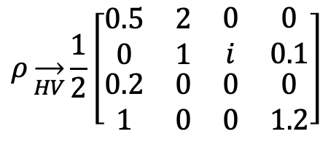
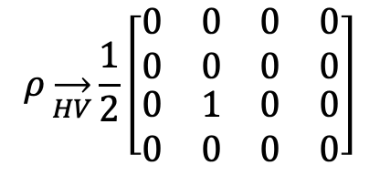
Density Matrix
$$ρ\overset{→}{HV}\frac{1}{2}\left[\begin{matrix}\begin{matrix}0 & 0 \\ 0 & 0\end{matrix} & \begin{matrix}0 & 0 \\ 0 & 0\end{matrix} \\ \begin{matrix}0 & 1 \\ 0 & 0\end{matrix} & \begin{matrix}0 & 0 \\ 0 & 0\end{matrix}\end{matrix}\right]$$
Same information as quantum state vector
Doesn’t matter how messy!
$$ρ\overset{→}{HV}\frac{1}{2}\left[\begin{matrix}\begin{matrix}0.5 & 2 \\ 0 & 1\end{matrix} & \begin{matrix}0 & 0 \\ i & 0.1\end{matrix} \\ \begin{matrix}0.2 & 0 \\ 1 & 0\end{matrix} & \begin{matrix}0 & 0 \\ 0 & 1.2\end{matrix}\end{matrix}\right]$$

Slide 32

Solutions …
New grouping of measurements
$$\left\{{\hat{W}′}_{1−3},{\hat{W}′}_{4−6},{\hat{W}′}_{7−9}\right\}$$
$$\left\{{\hat{W′}}_{1,4,7},{\hat{W}′}_{2,5,8},{\hat{W}′}_{3,6,9}\right\}$$
$$\left\{\hat{W}′′\right\}$$

